Slide 1
Linear algebra II

Slide 2
Vector spaces

Slide 3
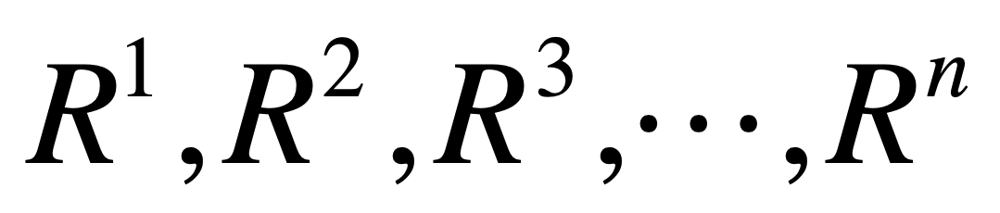

Slide 4
R^{n} space
consists of all vectors
with n components

Slide 5
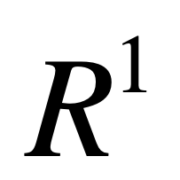
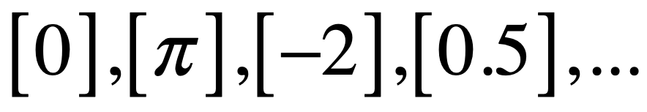
-2
0
0.5
π

Slide 6
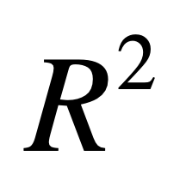
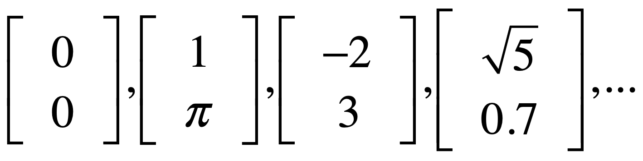
y
3
x
-2
1

Slide 7
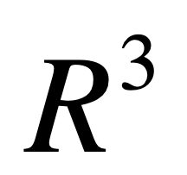
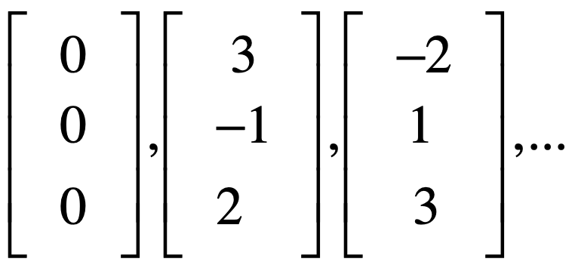
3
z
2
1
-2
3
x
-1
y

Slide 8
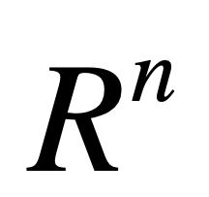
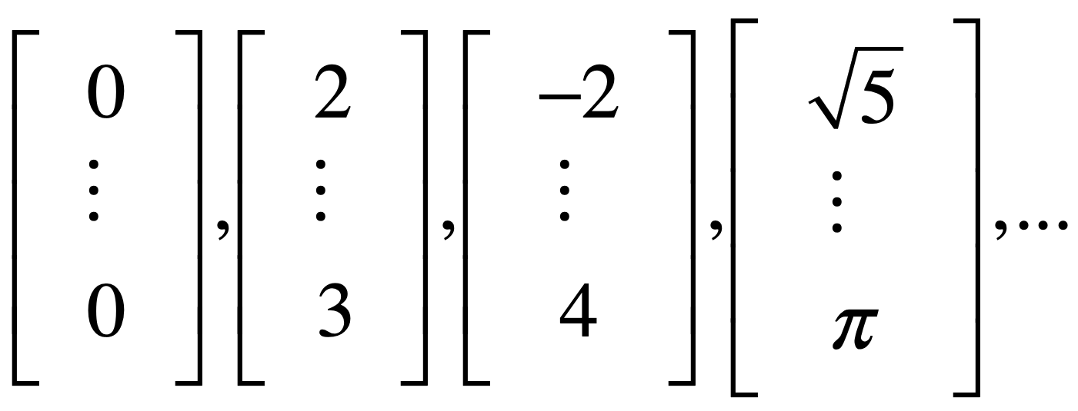

Slide 9
Column space

Slide 10
Columns of A^{mxn} in R^{m},
all their linear combinations
form a subspace:
column space, C(A)

Slide 11
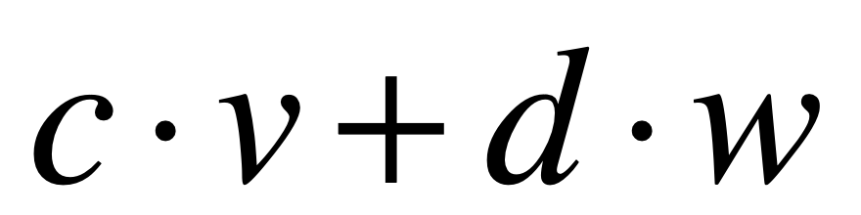
linear combinations
scalars
vectors

Slide 12
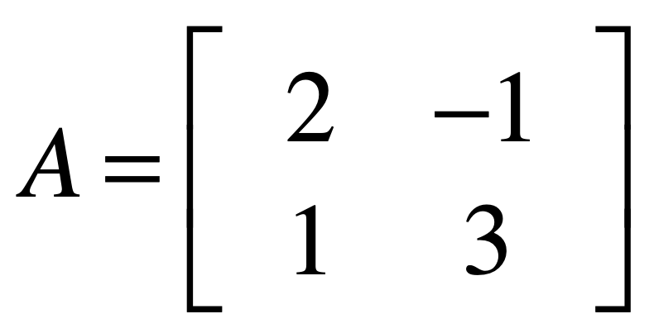

Slide 13
y
col2
3
col1
1
x
-1
2

Slide 14
col1 & 2 NOT on a line
-> independent

Slide 15
all their linear combinations?

Slide 16
y
x

Slide 17
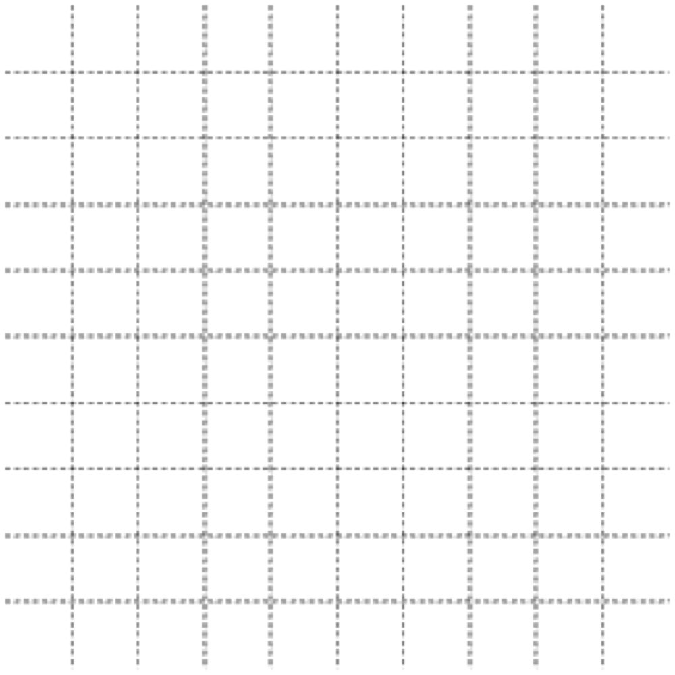
y
x
Whole space: R²
Column space: R²

Slide 18
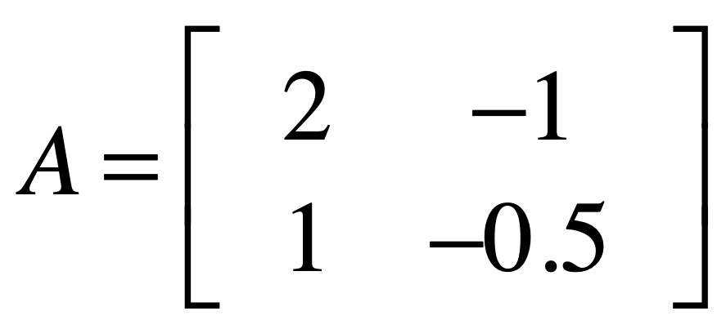

Slide 19
y
3
col1
1
x
-1
-5
2
col2

Slide 20
col1 & 2 on a line
-> dependent

Slide 21
all their linear combinations?

Slide 22
y
x
Whole space: R²
Column space: L

Slide 23
dim(whole space)
n rows
dim(column space)
n of independent columns

Slide 24
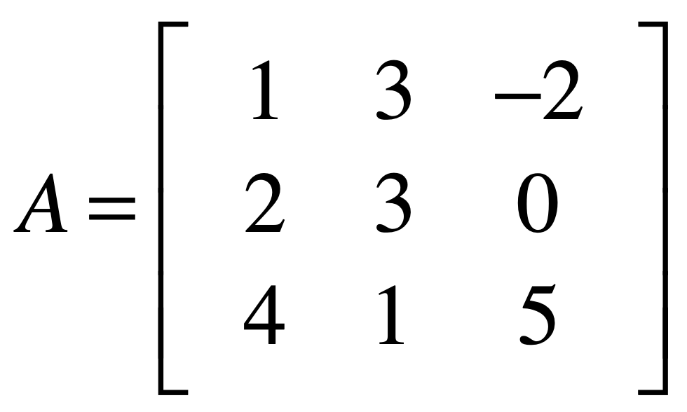
Whole space: R³
Column space: R³

Slide 25
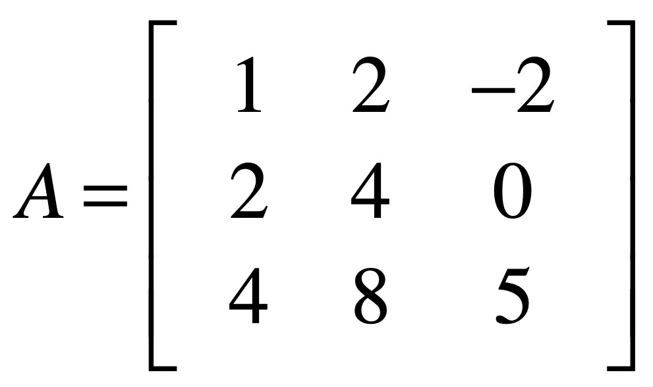
Whole space: R³
Column space: P

Slide 26
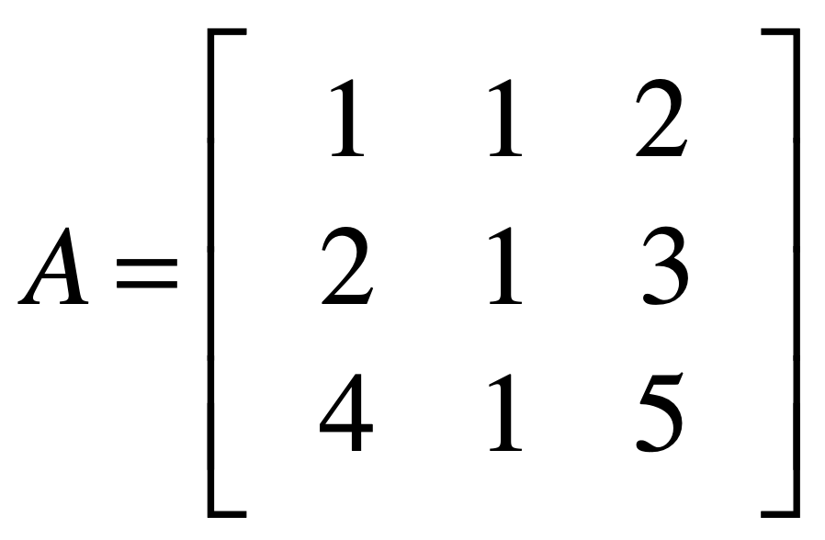
Whole space: R³
Column space: P

Slide 27
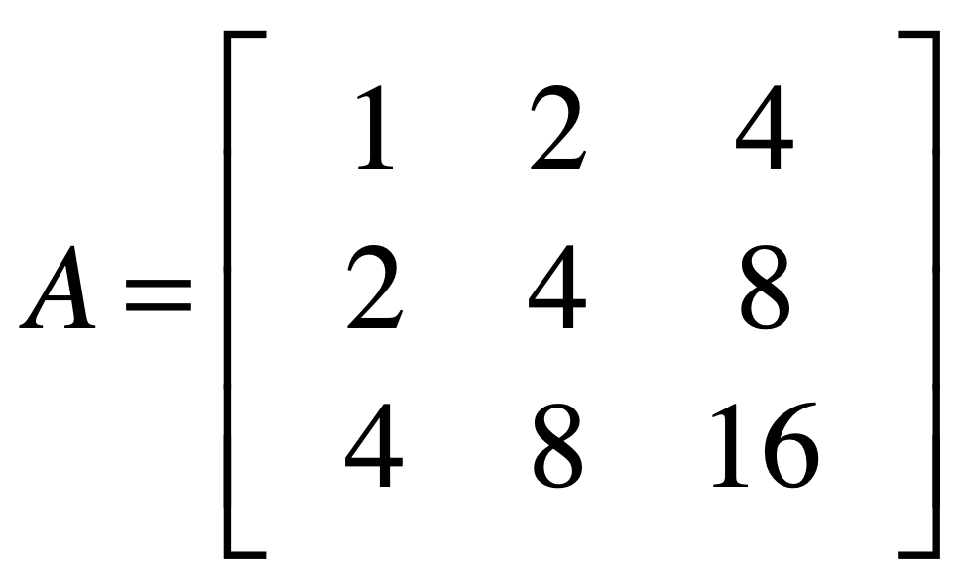
Whole space: R³
Column space: L

Slide 28
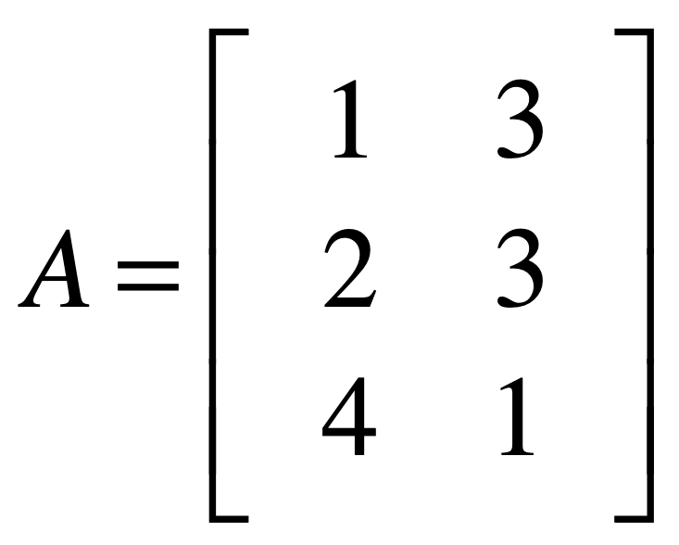
Whole space: R³
Column space: P

Slide 29
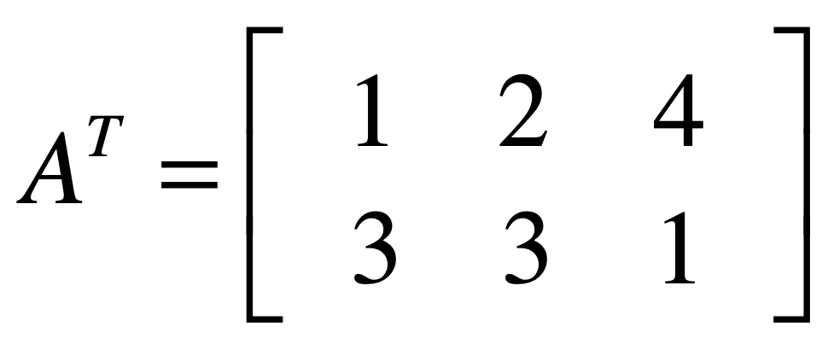
Whole space: R²
Column space: R²

Slide 30
Four spaces in a matrix

Slide 31
An mxn matrix
has two whole spaces:
R^{m} and R^{n}

Slide 32
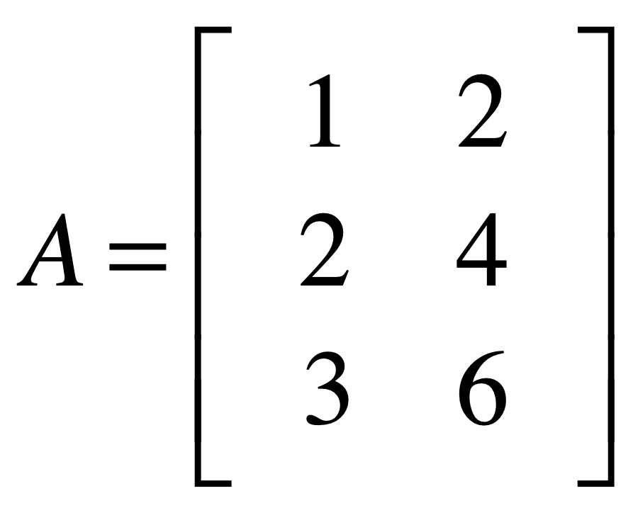

z
R³
x
whole space (column)
y
y
R²
whole space (row)
x

Slide 33

z
R³
column space
x
whole space (column)
y
y
R²
whole space (row)
row space
x

Slide 34
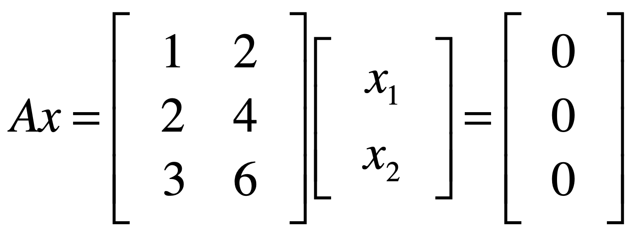
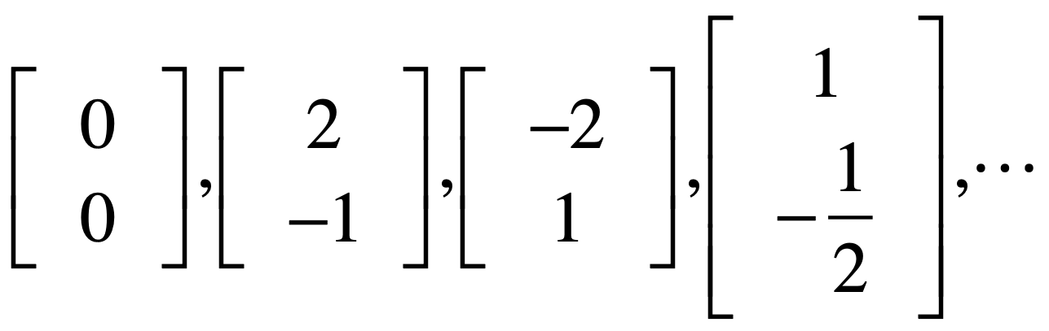
null space

Slide 35
z
R³
column space
x
whole space (column)
y
y
R²
whole space (row)
null space
row space
x

Slide 36
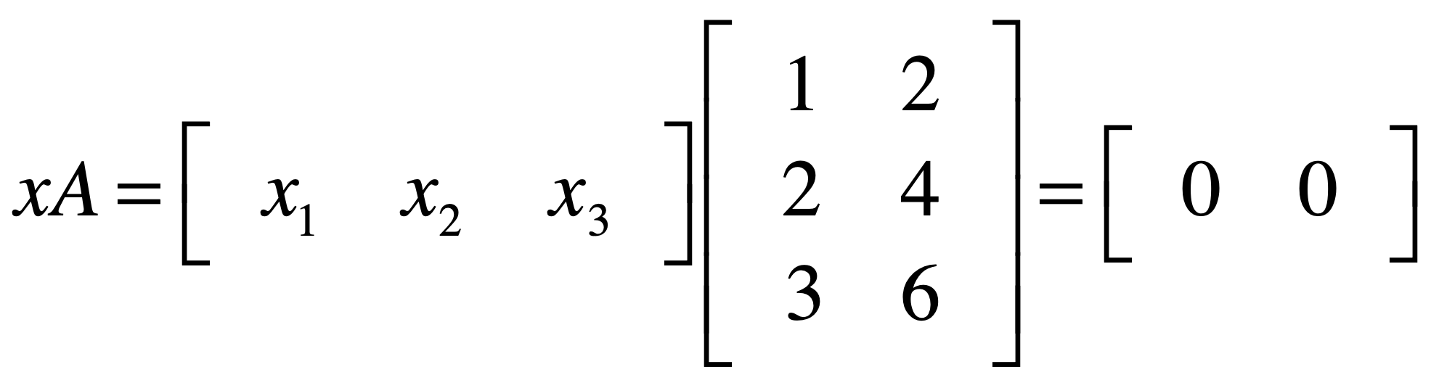
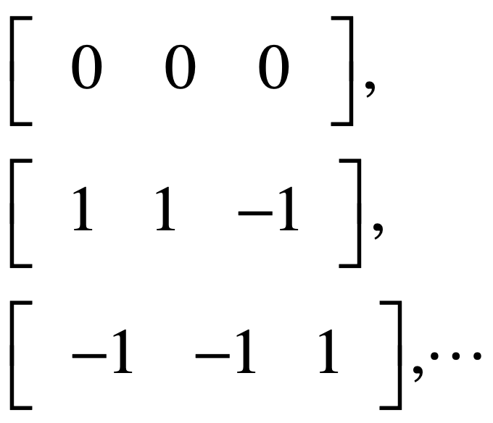
left null space

Slide 37
z
R³
column space
left null space
x
whole space (column)
y
y
R²
whole space (row)
row space
x

Slide 38
z
R³
column space
left null space
x
whole space (column)
y
y
R²
whole space (row)
null space
row space
x

Slide 39
row space
null space
r
n-r
column space
r
whole space (column)
m
left null space
m-r
n
whole space (row)

Slide 41
Linear transformation

Slide 42
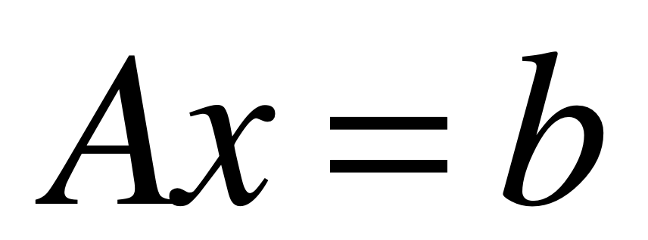

Slide 43
place x on original grid
transform x onto A grid
read transformed x
on original grid (=b)

Slide 44
example 1

Slide 45
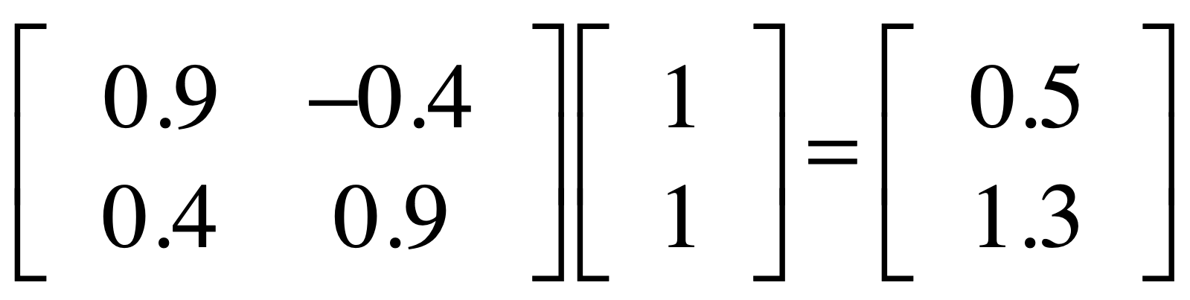

Slide 46

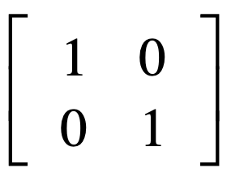
basis vector
basis vector
original grid

Slide 47

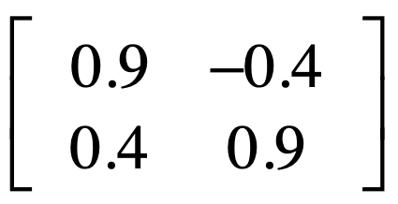
basis vector
basis vector
A (transformation) grid

Slide 48
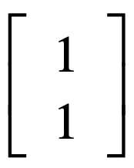

Slide 49
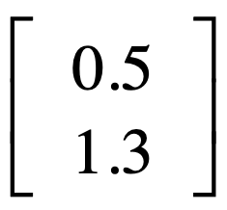

Slide 50
example 2

Slide 51
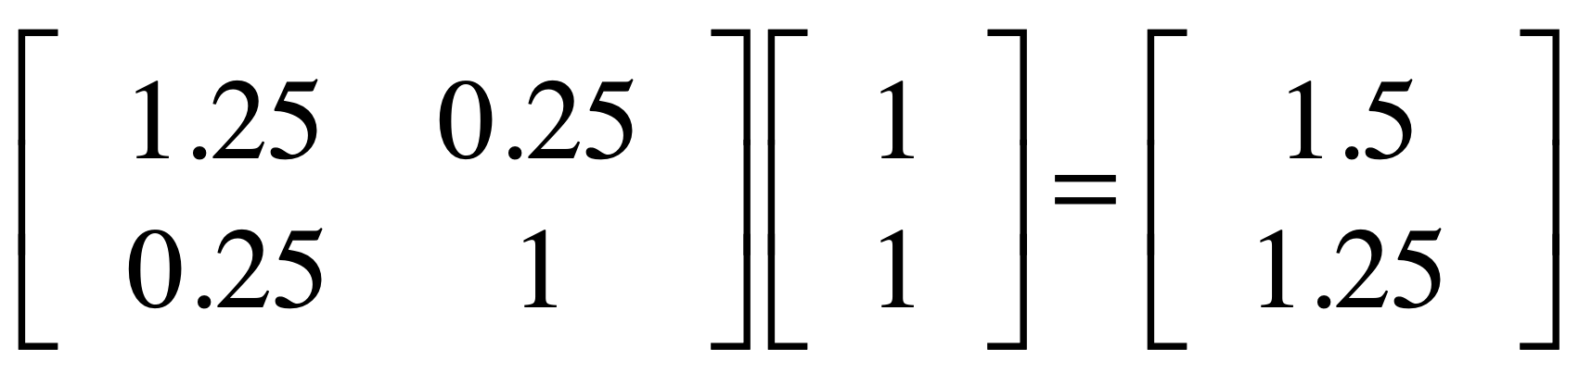

Slide 52
basis vector
basis vector
original grid

Slide 53

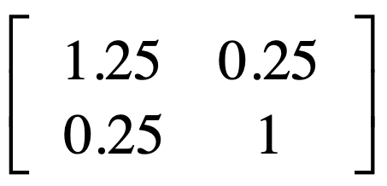
basis vector
basis vector
A (transformation) grid

Slide 55
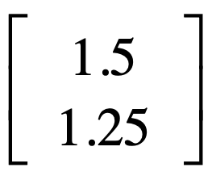

Slide 56
example 3

Slide 57
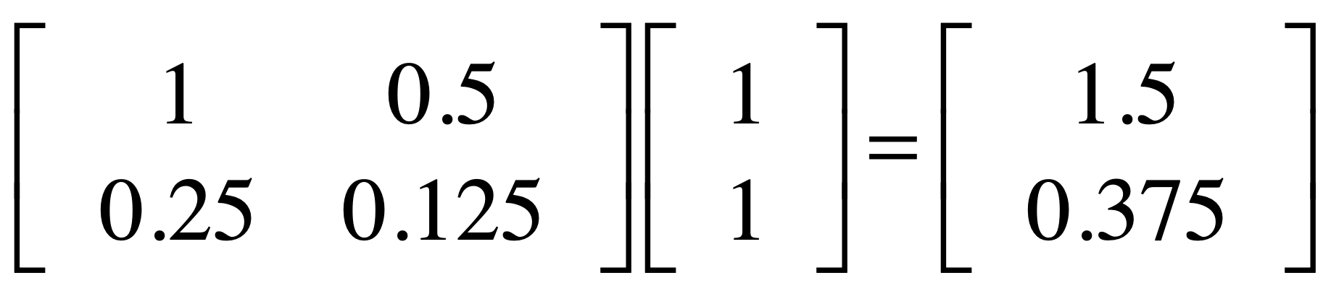

Slide 58
basis vector
basis vector
original grid

Slide 59
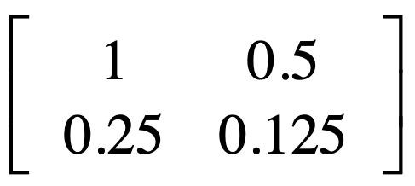
basis vectors
A (transformation) grid

Slide 61
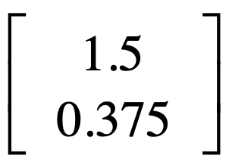

Slide 62
Detransformation:
Inverse matrix

Slide 63
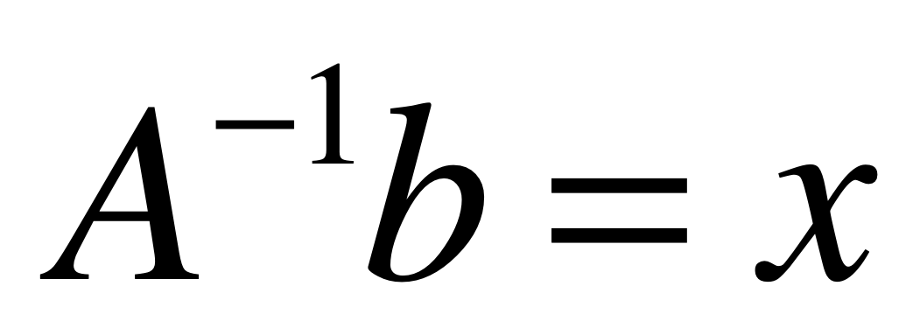

Slide 64
example 1

Slide 65
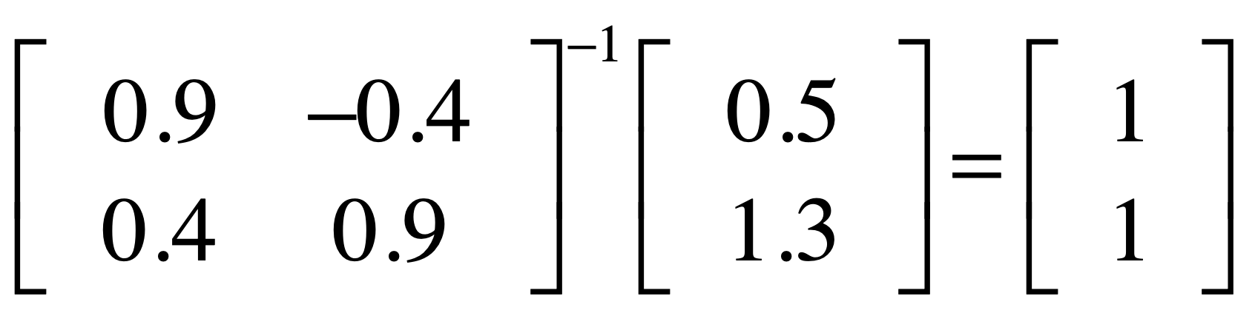

Slide 66
basis vector
basis vector
A (transformation) grid

Slide 67
basis vector
basis vector
original grid

Slide 70
example 2

Slide 71
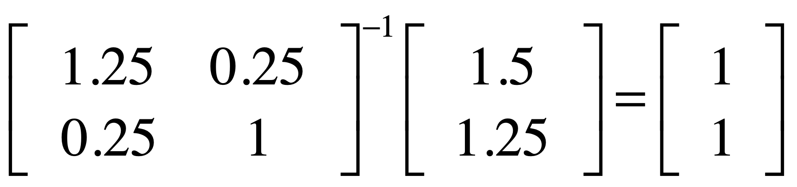

Slide 72
basis vector
basis vector
A (transformation) grid

Slide 73
basis vector
basis vector
original grid

Slide 76
example 3

Slide 77
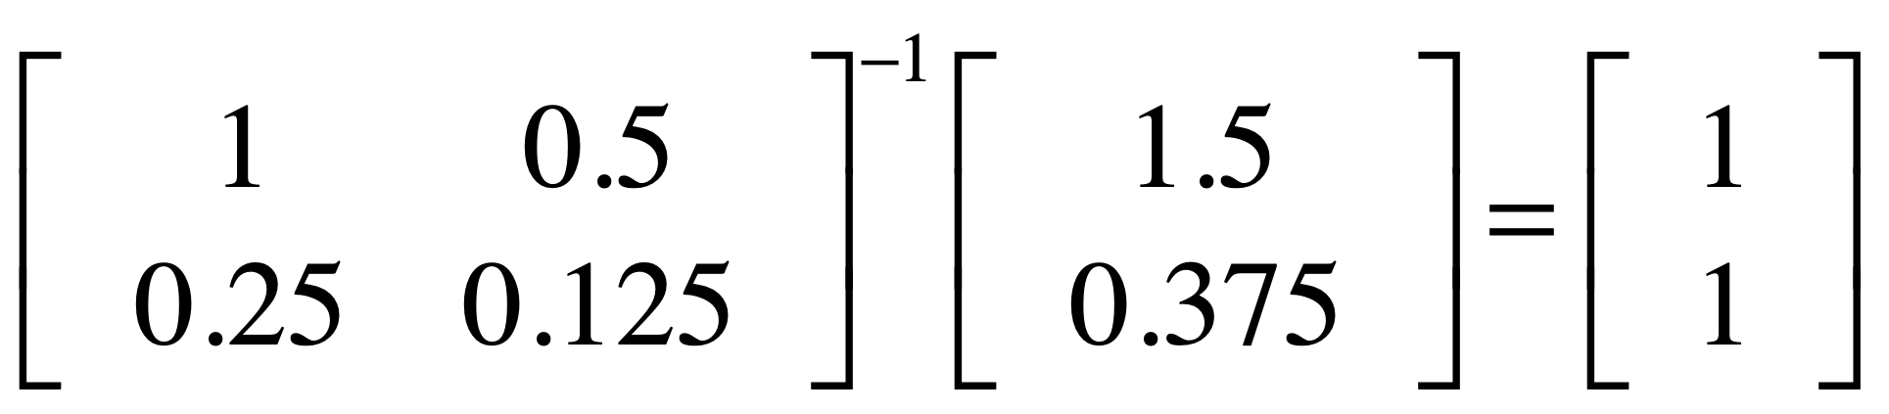

Slide 78
basis vector
basis vector
original grid

Slide 79
basis vectors
A (transformation) grid

Slide 81
?
?
?
not invertible
?
?
?
?
?
?
?

Slide 82
eigenvector

Slide 83
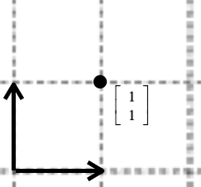
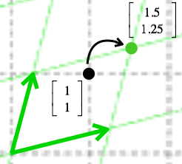
Av=b
A transforms v to b
x space
b space

Slide 84
Among all v,
some v is parallel to Av.
that v is eigenvector

Slide 85
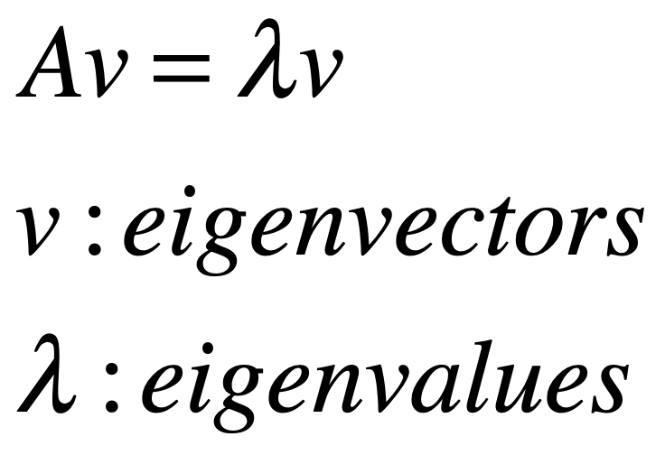

Slide 86
Visualizing
eigenvectors
http://setosa.io/ev/eigenvectors-and-eigenvalues/

Slide 87
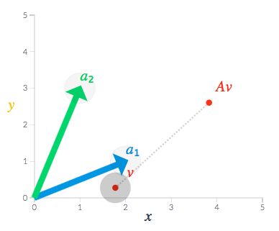
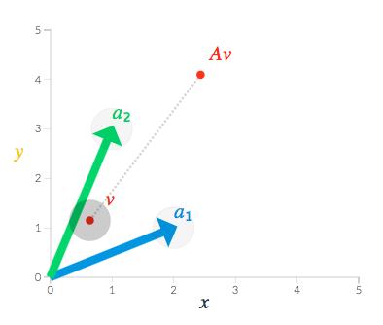

Slide 88
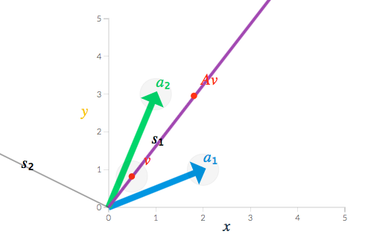
eigenspace

